Slide 1
Copyright and OER basics
Sara Benson, Copyright Librarian

Slide 2
It is really easy to get a ©
originality
fixation
copyright

Slide 3
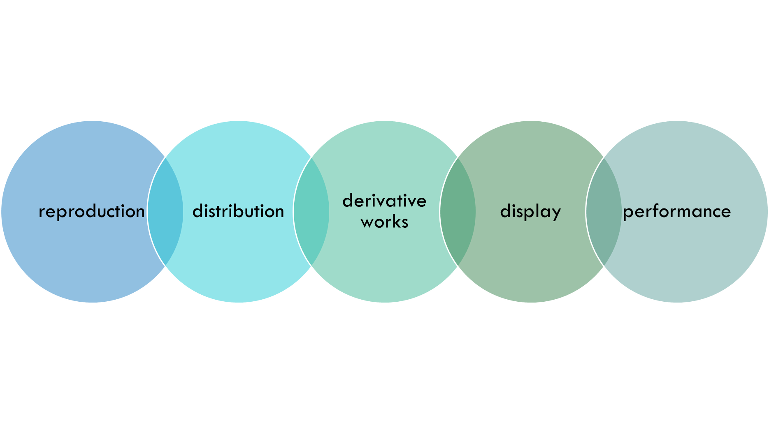
Exclusive Rights of the Author

Slide 4

Copyright lasts a long, long time
Today, the default copyright length is life of the author + 70 years after death.
Thanks Disney

Slide 5
For OER, three things to know
1) What kinds of stuff can you use in your work?
2) How do you properly attribute/cite those items?
3) Understand the license you will put on YOUR work (CC-BY license) to make it an Open Educational Resource so that others can use it, too.

Slide 6
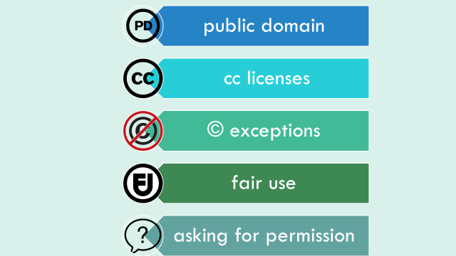
Today, we will discuss the public domain and CC licenses… next time… fair use!

Slide 7
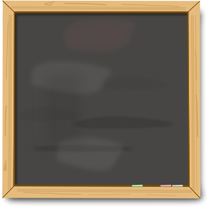
Published in the United States
pre-1929
🅑🅔🅒🅐🅤🅢🅔 🅜🅐🅣🅗
1928
+95
2023

Slide 8
Where to find public domain items?
So many places!
There’s a really helpful guide at:
Publicdomainreview.org/guide-to-finding-interesting-public-domain-works-online/
I really like unsplash.com for photos, personally
Also check out this LibGuide! https://guides.library.illinois.edu/oer

Slide 9
Government documents = public domain
If it ends in .gov, likely it is in the public domain
BUT, check for images/charts… sometimes those were borrowed too and are still in copyright!!!

Slide 10
What about the creative commons?
Some CC licensed works are in the public domain.
Check out CC0 works, for instance.
Most are not. The broadest license is CC-BY (which is the same license you will use on your OER).

Slide 11
Let’s practice…
Let’s say I want to find a nice picture of a Beagle to use in a powerpoint at a conference. I am looking for a creative commons licensed work, specifically.
So, I head to creativecommons.org
Let’s go there now!

Slide 12
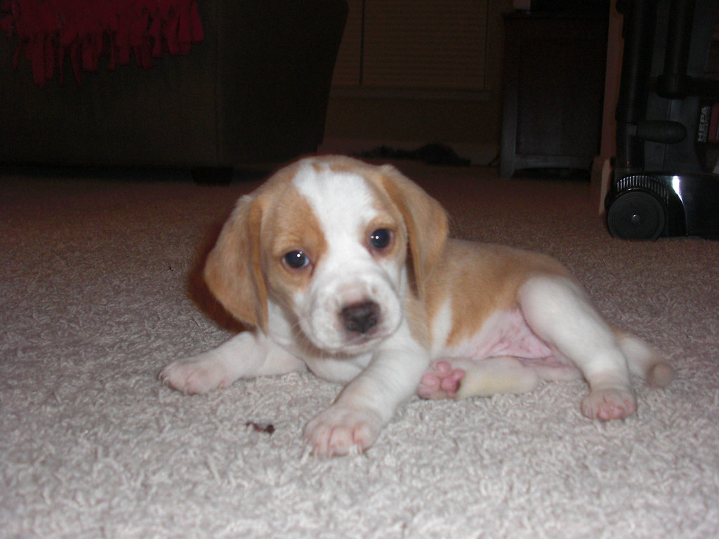
My powerpoint
"Lola, My Beagle Puppy" by Bukowsky18 is licensed under CC BY 2.0.

Slide 13
What about other licenses?
NC means “non-commercial”
ND means “no derivatives” and is the most restrictive—you can’t make any changes to the item
BUT, all CC licenses permit fair use (which we will discuss more next time)…

Slide 14
Let’s do that beagle search again…
Back to the creative commons…

Slide 15
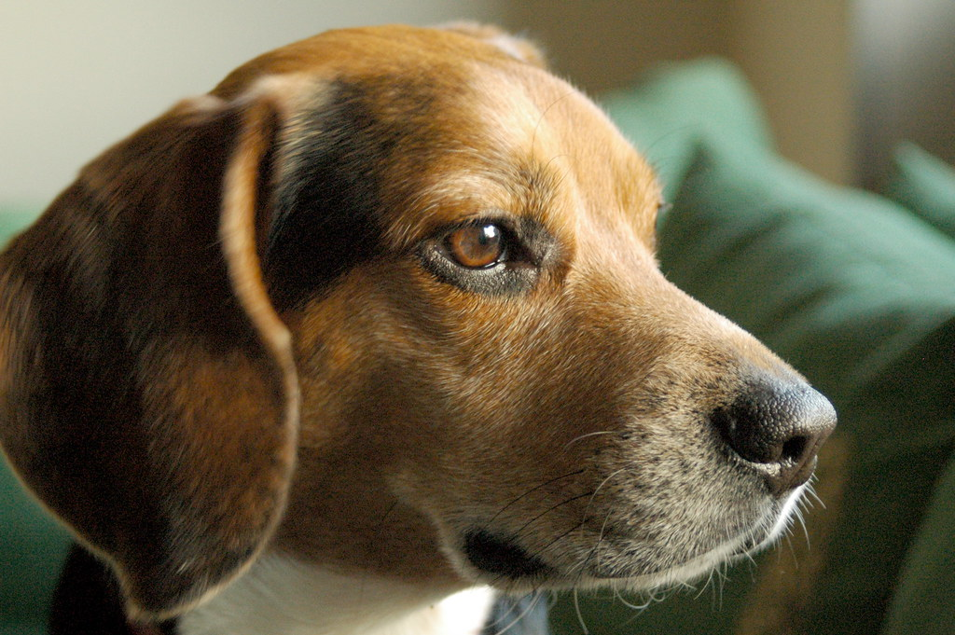
Can I do this?
"Mr. Beagle" by Macorig Paolo is licensed under CC BY-NC-ND 2.0.

Slide 16

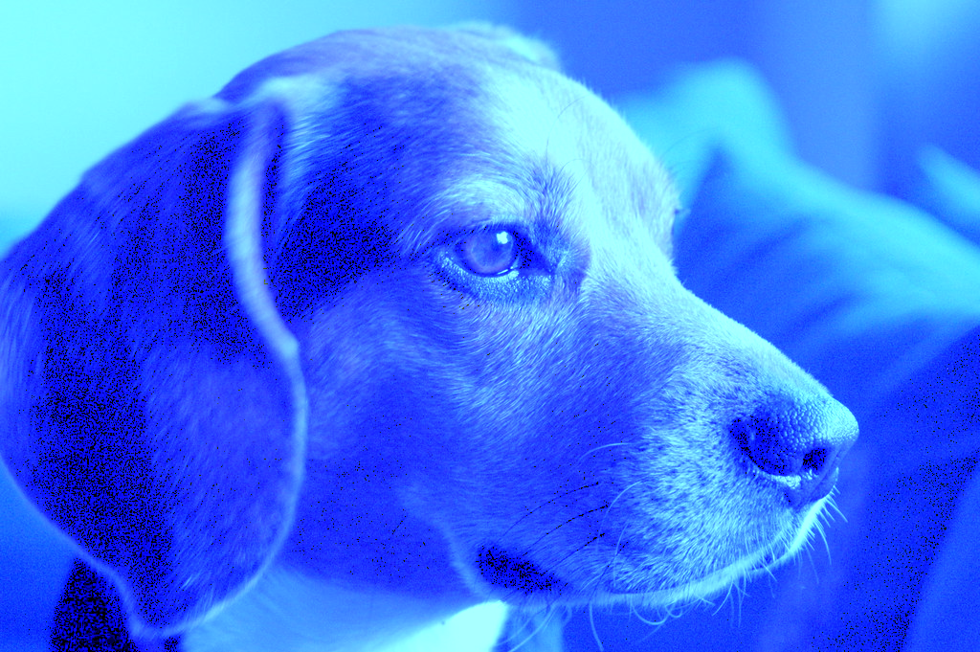
What about this?
"Mr. Beagle" by Macorig Paolo is licensed under CC BY-NC-ND 2.0.

Slide 17
What does “SA” mean?
SA means “share alike.” For instance, if I put CC-BY-SA 4.0 it means that anyone who uses my work to create a derivative work must also use the same license (i.e. my work will presumably never be used under a more restrictive license).
But, note that it only applies to those creating a derivative work (i.e. changing the work in some meaningful way). If you simply copy and paste a photo and do nothing to change it, you are not creating a derivative work. Thus, you do not have to add the “SA” to your CC-BY license on your OER. Make sense? You would simply have to cite the photo appropriately with its CC-BY-SA 4.0 license. Such as:

Slide 18
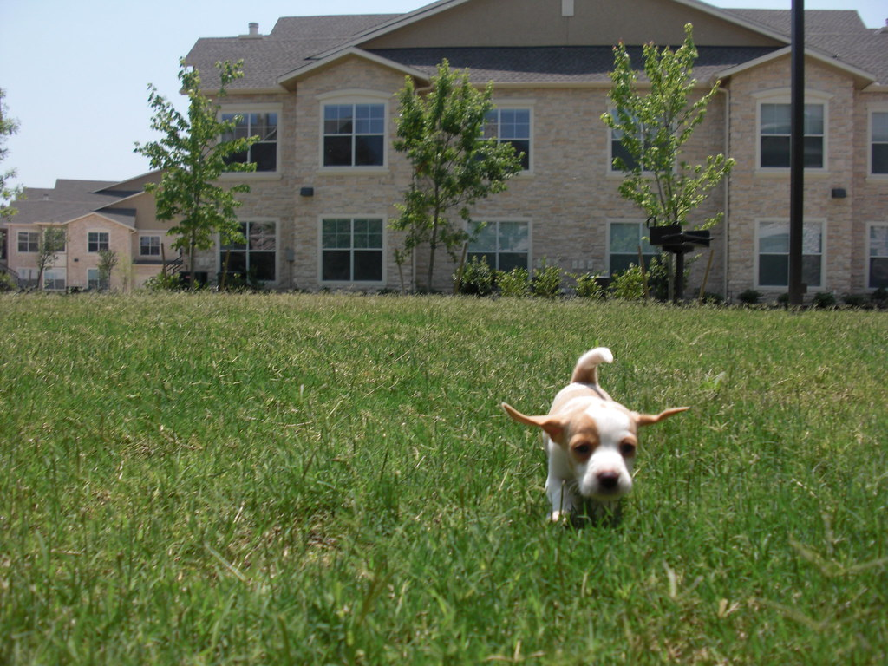
Share alike example
"Fly like a Beagle!" by Bukowsky18 is licensed under CC BY-SA 2.0.

Slide 19
What can people do with YOUR OER???
Remember, it will have the CC-BY license…

Slide 20
Great, but…
There are some things I need to use that are still in copyright.
I know. So, you have two options:
1) Assert fair use (we will discuss this next time); or
2) Ask for permission (make sure you get permission in writing—email is fine—from the copyright owner—usually the publisher—and note that you are creating an OER that will be openly licensed on the internet).

Slide 21

Questions?

Slide 22
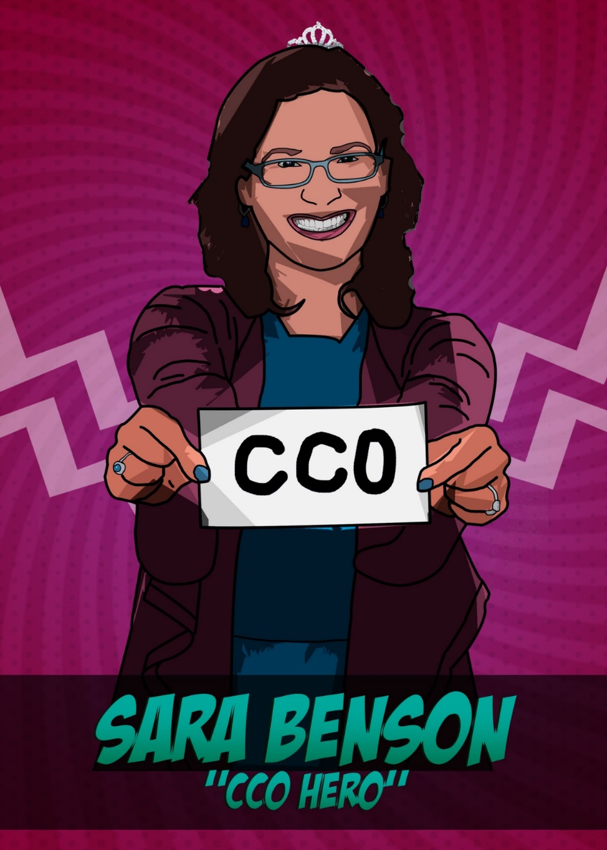
Questions?
Remember, you can always contact me:
srbenson@illinois.edu

